Slide 1
Introduction To Jquery
PRESENTER: MOHAMMAD ADIL

Slide 2
What Is Jquery ?
jQuery is a JavaScript Library.
jQuery greatly simplifies JavaScript programming.
jQuery is easy to learn.
A lightweight and concise JS library.
Helps to make JS programming easy and faster.

Slide 3
WHAT IS JQUERY ?
Feature rich and open source library which simplifies complex tasks.
Easy to use API which is compatible with browsers.
Common tasks into built-in methods.
Reduce time in writing lines of code.

Slide 4
Javascript Vs Jquery
JAVASCRIPT
JQUERY
document.getElementById("IdName");
document.getElementsByClassName("ClassName");
document.getElementsByTagName("TagName");
$("#IdName")
$(“.ClassName")
$(“TagName")

Slide 5
WHAT IS JQUERY ?
jQuery is a lightweight, "write less, do more", JavaScript library.
The purpose of jQuery is to make it much easier to use JavaScript on your website.
jQuery takes a lot of common tasks that require many lines of JavaScript code to accomplish, and wraps them into methods that you can call with a single line of code.
jQuery also simplifies a lot of the complicated things from JavaScript, like AJAX calls and DOM manipulation.

Slide 6
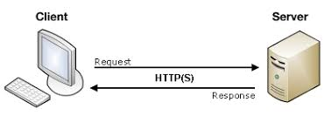
Client- Server Architecture

Slide 7
AJAX OVERVIEW
2 types of request is used
Synchronous
Asynchronous

Slide 8
DOCUMENT OBJECT MODEL (DOM) IN JAVASCRIPT
When a webpage or html page loads in the browsers, browser creates a DOM (document object model) for the page.
DOCUMENT – HTML PAGE (DOCUMENT)
OBJECT – TAGS OR ELEMENTS AND ATTRIBUTES IN HTML PAGE
MODEL – IN DOM, TREE STRUCTURE OF HTML ELEMENTS.

Slide 9
DOCUMENT OBJECT MODEL (DOM) IN JAVASCRIPT
So the html DOM is browser created tree structure arrangement of elements and attributes.

Slide 10
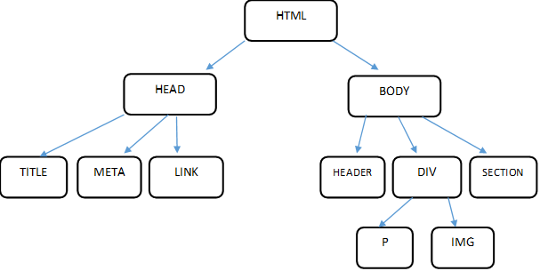
DOCUMENT OBJECT MODEL (DOM) IN JAVASCRIPT

Slide 11
DOCUMENT OBJECT MODEL (DOM) IN JAVASCRIPT
Dom is a standard to understand the structure of html page so that we can create, read, update, and delete and manages dom elements using JavaScript methods.
Html dom helps you to understand and control the element structure using JavaScript methods. If you understand the dom structure of a html page, you can easily control its elements, attributes and all nodes.

Slide 12
DOCUMENT OBJECT MODEL (DOM) IN JAVASCRIPT
WHAT IS A NODE?
According to html dom, everything in a html page is node.
Entire document is a document node.
Each element in a html page is element node.
All text of document is text nodes.
All attributes of elements are attribute nodes.
Comments of page are comment nodes.

Slide 13
WHAT IS JQUERY ?
The jQuery library contains the following features:
HTML/DOM manipulation
CSS manipulation
HTML event methods
Effects and animations
AJAX

Slide 14
Purpose Of Jquery
The purpose of jQuery is to make it much easier to use JavaScript on your website

Slide 15
Benefits of jQuery over JS
Unobtrusive JS
Web page designing through unobtrusive JS
Separates functionality between presentation and structure of Web page
Lightweight
Reduced library size is in kilobytes (KB)
Browser cache the library throughout Websites instead of downloading it.

Slide 16
Benefits of jQuery over JS
Easy to use
Simple and robust syntax
Reduced lines of code
Library uses CSS3 selector specification
Big and focused library
Perform variety of functions through single library
jQuery offers several utility functions

Slide 17
Benefits of jQuery over JS (1-2)
Extensibility
Plugin framework third party and official plugins
Any feature can be included through plugin
Browser Compatibility
Resolves cross browser issues
jQuery implemented compatibility code
Strong Community
Exclusive community where developers improve functionality
Offers several plugins which accelerate Web development process Strong Community

Slide 18
Benefits of jQuery over JS (1-2)
AJAX Support
Creates AJAX templates
Offers smooth interfaces and efficient loading AJAX Support
Comprehensive Documentation
Official website has in-depth documentation and tutorials
Helps beginners for easy use

Slide 19
Why jQuery?
There are lots of other JavaScript libraries out there, but jQuery is probably the most popular, and also the most extendable.
Many of the biggest companies on the Web use jQuery, such as:
Google
Microsoft
IBM
Netflix

Slide 20
What You Should Already Know
Before you start studying jQuery, you should have a basic knowledge of:
HTML
CSS
JavaScript

Slide 21
TEXT EDITORS
NOTEPAD++
BRACKETS
SUBLIME
VISUAL STUDIO CODE
ADOBE DREAMWEAVER etc
We use Adobe DreamWeaver 2019 in this tutorial series.

Slide 22
Adding jQuery to Your Web Pages
There are several ways to start using jQuery on your web site. You can:
Download the jQuery library from jQuery.com
Include jQuery from a CDN, like Google (Content Delivery Network)

Slide 23
Downloading jQuery
There are two versions of jQuery available for downloading:
Production version - this is for your live website because it has been minified and compressed
Development version - this is for testing and development (uncompressed and readable code)

Slide 24
jQuery CDN
If you don't want to download and host jQuery yourself, you can include it from a CDN (Content Delivery Network).
Both Google and Microsoft host jQuery.
To use jQuery from Google or Microsoft, use one of the following:
Google CDN:
<head> <script src="https://ajax.googleapis.com/ajax/libs/jquery/3.4.1/jquery.min.js"></script> </head>

